Slide 1
Review of the paper “Smart Home Security Analysis System Based on The Internet of Things”
By
Name: Mahmudul Hassan
ID: 20101368
mahmudul.hassan1@g.bracu.ac.bd
For
Annajiat Alim Rasel
annajiat@bracu.ac.bd
ST: Farah Binta Haque
RA: Md Sabbir Hossain

Slide 2

Table of contents
Introduction
Security Concerns
Research Gap
System Design Overview
Experimental Results
Related Work and Conclusion
T

Slide 3

Introduction
Defining IoT and its role in connecting devices.
Increase in smart home device adoption.
Emergence of security vulnerabilities in smart home devices.

Slide 4
Security Concerns
Instances of compromised smart home devices.
Transformation into "monitoring devices" or launching DDoS attacks.
Lack of protection functions in current IoT devices.

Slide 5
Research Gap
Growing research on smart home security, still in early stages.
Current market IoT devices lacking protection functions.
Dependency on firmware updates for vulnerability fixes.

Slide 6
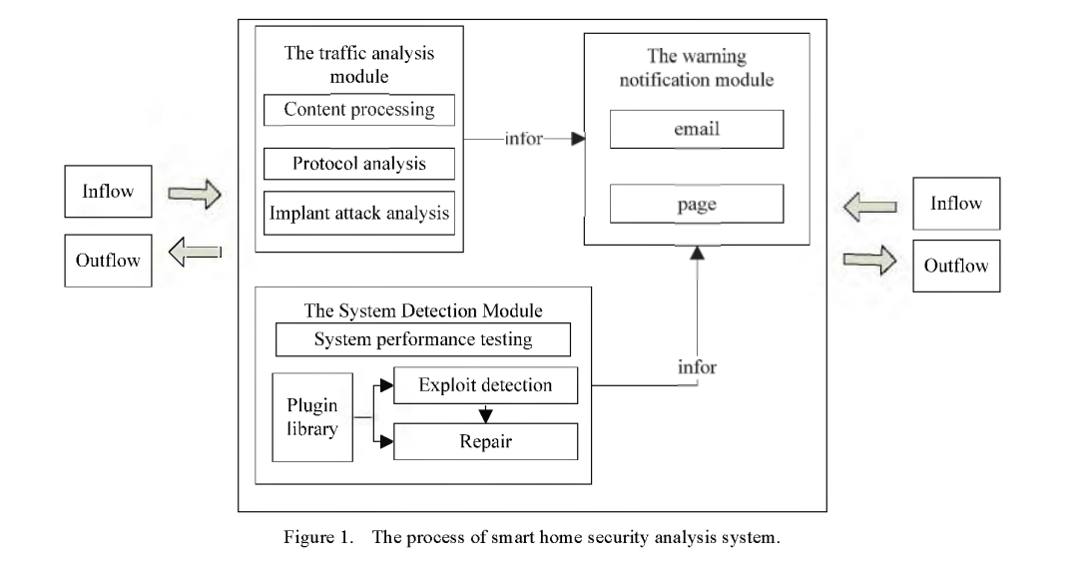
System Design Overview
Introduction of the proposed smart home security analysis system.
Focus on detecting contact attacks (firmware implantation, non-contact attacks, and attacks on computing resources).
Ability to cover potential vulnerabilities with plug-ins.

Slide 7
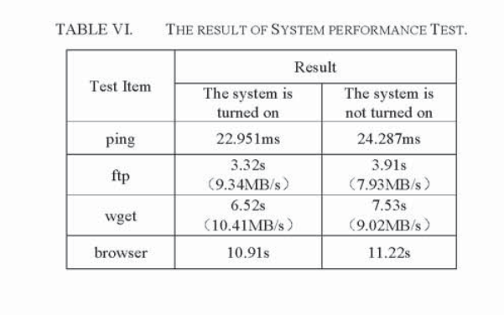
Experimental Results
Successful defense against contact and non-contact attacks.
Minimal impact on home network performance in daily usage scenarios.

Slide 8
Related Work and Conclusion
Overview of related studies .
Summary of key findings and contributions.
Implications for smart home security and device performance.
Future directions for research and system improvement.

Slide 9
Thank You
For any queries contact: mahmudul.hassan1@g.bracu.ac.bd

